Slide 1
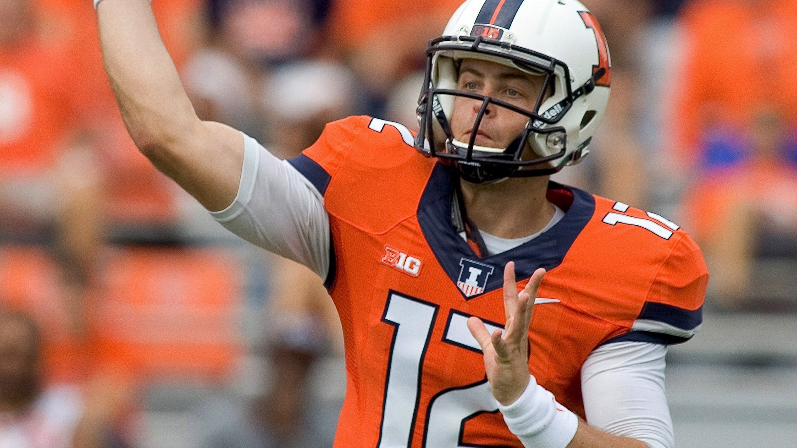

A Bayesian Approach to Predicting NFL Quarterback Scores in Fanduel Tournaments
Aaron Ray (aaronwr2)
Michael Chan (mhchan3)
Kiomars Nassiri (nassiri2)
STAT 578 - ABM

Slide 2

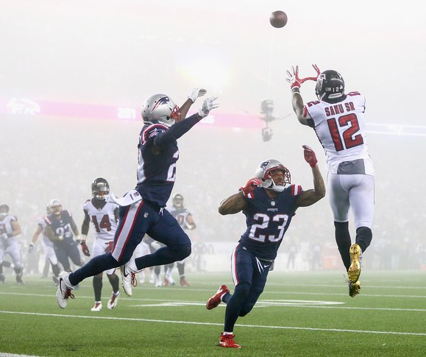
Fantasy Football
Participants in a Fantasy Football game act as the managers of a virtual football team and try to maximize their points by picking up the best line-up.
Points are given based on actual performance of players in real-world competition.
Each team is allowed a pre-determined number of players on its roster, as well as a specified number at each position that can or must be used in each game (the "starters").

Slide 3


FanDuel
For the purpose of this project we have chosen to work with the data gathered from the FanDuel internet company.
“FanDuel is a web-based fantasy sports game and with 6 million registered users and is the second largest daily fantasy sports company (as measured by entry fees and user base) in the daily fantasy sports industry” – Wikipedia

Slide 4
Objective & Research Questions
We have leveraged a Hierarchical Bayesian approach with the Markov Chain Monte Carlo method to predict the fantasy points likely to be scored by an NFL quarterback in any given game.
In this project we are interested to know:
What features can help us effectively predict Fanduel points players receive in a future match?
How reliable are the predictions for the future performance of players?

Slide 5

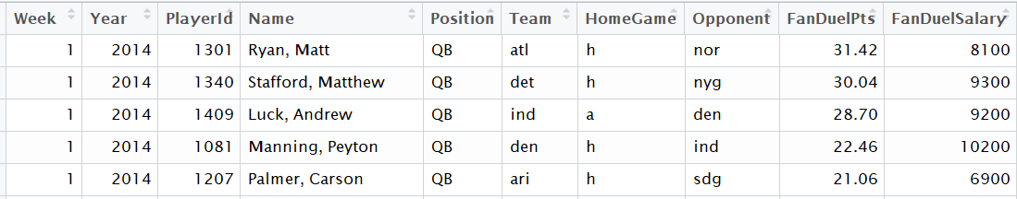
Fanduel Stats Dataset
Historical data on the performance of the players is extracted from the RotoGuru website.
Seasons 2014 – 2017, Weeks 1- 16
Data includes information about:
The Fanduel points received by each player
Player’s position in a given week,
Player’s opponent team in a given week
Etc.
Raw Data Fields | Description
Week | Match Week
Year | Match Year
Player ID | Player ID
Name | Player Name (Last, First)
Position | Player’s Position
Team | Player’s Team
HomeGame | Home/Away Indicator
Opponent | Player’s Opponent Team
FanDuelPts | FanDuel Points
FandDuelSalary | FanDuel Salary

Slide 6
Data Preparation and Wrangling
Raw data, then, undergoes different data preparation processes as follows:
Data Cleansing:
Removing invalid records, binarizing indicator columns, Fixing naming issues, etc.
Data Wrangling:
6-week running mean and SD of PAPs.
5-week running mean and SD of the points scored by players who play a certain position for a given team.
Offensive and Defensive Ranks (?)
Points Allowed to Position (PAP): This metric represents the typical total points that each player’s opponent has allowed to players of that position in any given game.

Slide 7
Overview of the Bayesian Model
Response Variable:
FanDuel Points Received
Predictor Variables:
5-week running mean of the points scored
6-week running mean of PAPs.
Position
Home Advantage Indicator
Rank: The rank of a player based on recent performance.

Slide 8
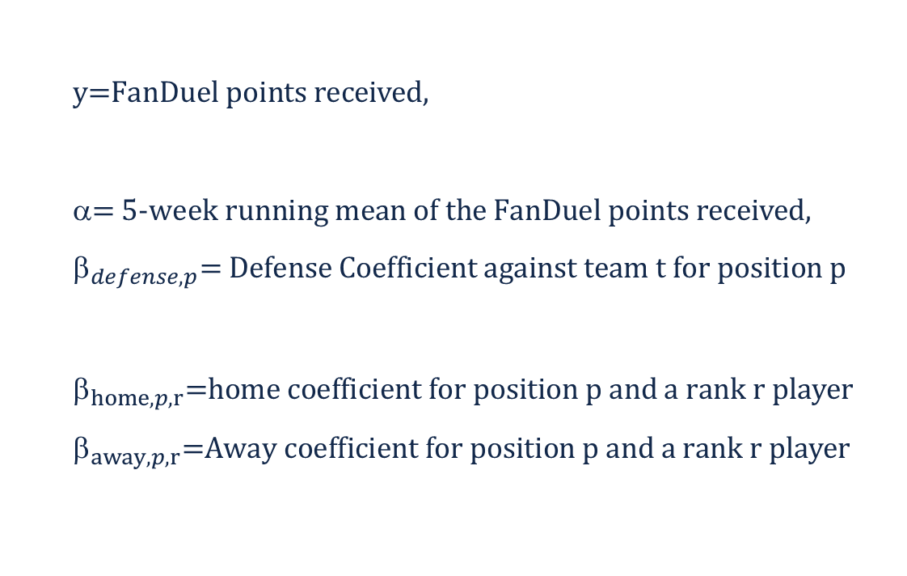
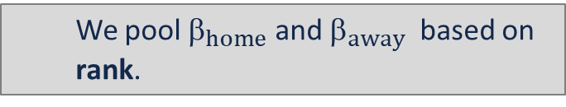
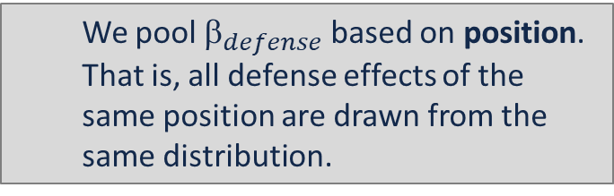
Sampling Model
We have assumed performance (FanDuel points) is normally distributed around a true mean value
$$\text{y}\text{=}\text{FanDuel} \text{points} \text{received}\text{,}$$
$$\text{= }\text{5-}\text{week} \text{running} \text{mean} \text{of} \text{the} \text{FanDuel} \text{points} \text{received}\text{,}$$
$${\text{}}_{defense,p}\text{= }\text{Defense} \text{Coefficient} \text{against} \text{team} \text{t} \text{for} \text{position} \text{p}$$
$${\text{}}_{home,p,r}\text{=}\text{home} \text{coefficient} \text{for} \text{position} \text{p} \text{and} \text{a} \text{rank} \text{r} \text{player}$$
$${\text{}}_{away,p,r}\text{=}\text{Away} \text{coefficient} \text{for} \text{position} \text{p} \text{and} \text{a} \text{rank} \text{r} \text{player}$$
We pool ${\text{}}_{defense}$based on position. That is, all defense effects of the same position are drawn from the same distribution.
We pool ${\text{}}_{home}$ and ${\text{}}_{away}$ based on rank.

Slide 9
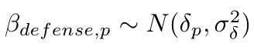
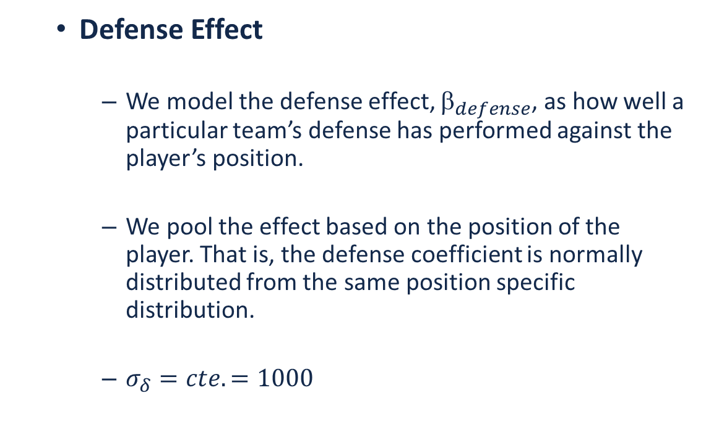
Sampling Model (Cont’d)
Defense Effect
We model the defense effect, ${\text{}}_{defense}$, as how well a particular team’s defense has performed against the player’s position.
We pool the effect based on the position of the player. That is, the defense coefficient is normally distributed from the same position specific distribution.
$σ_{δ}=cte.=1000$

Slide 10
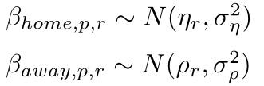
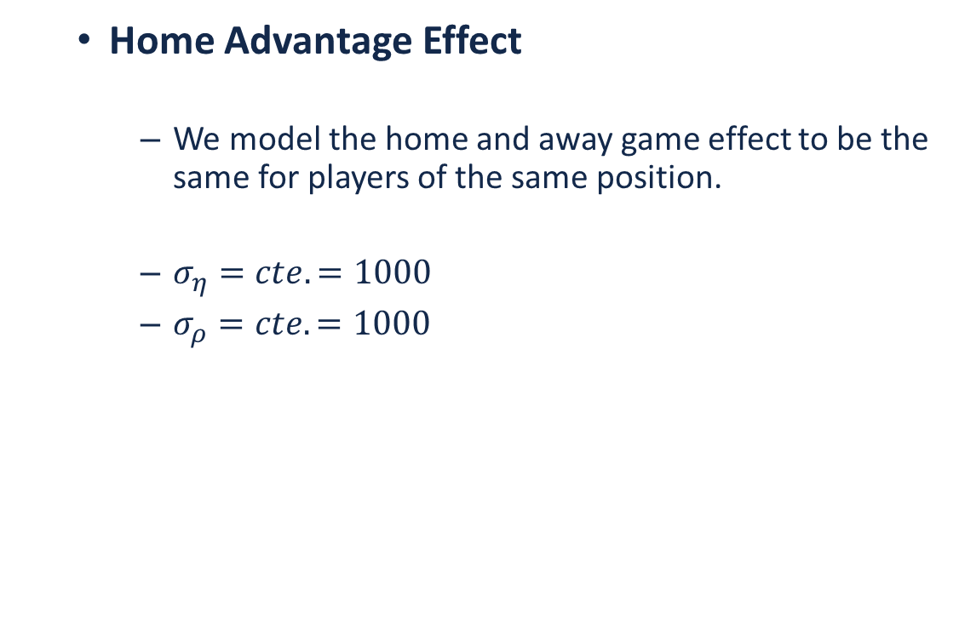
Sampling Model (Cont’d)
Home Advantage Effect
We model the home and away game effect to be the same for players of the same position.
$σ_{η}=cte.=1000$
$σ_{ρ}=cte.=1000$

Slide 11
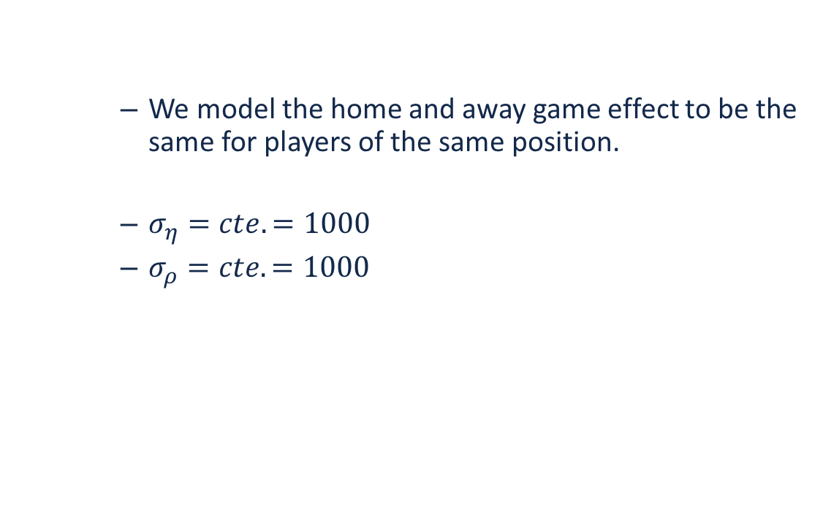
Priors
We model the home and away game effect to be the same for players of the same position.
$σ_{η}=cte.=1000$
$σ_{ρ}=cte.=1000$

Slide 12
Bayesian Hierarchical Model
DAG For the Model
General Model Descriptions – Refer to Course slides.

Slide 13
Bayesian Hierarchical Model
Sampling Distribution:

Slide 14
Bayesian Hierarchical Model
Diffuse Prior Distributions:

Slide 15
Bayesian Hierarchical Model
DAG For the Model

